Slide 1
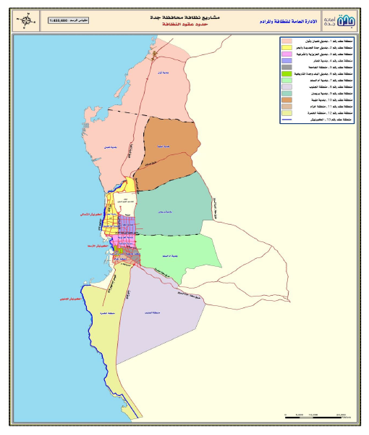
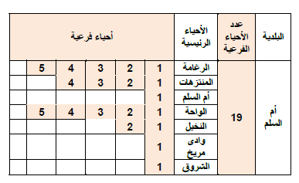
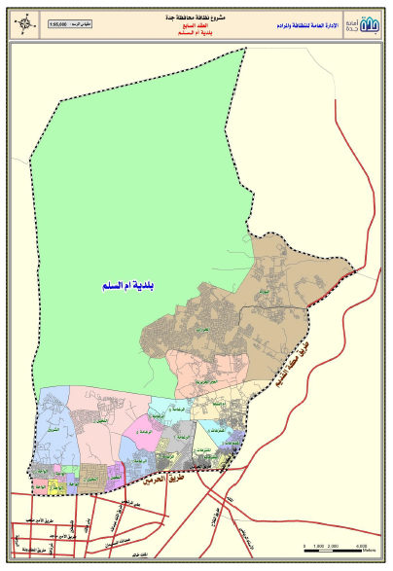


GIS System
- Allocation of the scope of the contract area
منطقة العقد
الأسواق
حدود العقد

Slide 2
GIS System
Instructions:
The first stage:
- The system includes the following:
1- Municipalities belonging to the contract area
2. The main neighborhoods of each municipality
3. Sub-neighborhoods of each major district
4. Tracks belonging to each sub-district
Each of the above points must contain the coordinates and be reflected on the map

Slide 3
GIS System
The second phase:
Since the contract contains a variety of services, each service is linked to the scope of the area
For example: Clean up the scatter of waste:
Include the following relationship:
1. The service is linked to the scope of work by geographical location
a. The service is linked to a workforce, and each worker covers a certain area on the geographical location
B) The service is connected to equipment or tracks and in each round as follows:
From camp to point A (express container location)
Point A to point b Point B to the transition station The transition station to the landfill Waste is finally sorted

Slide 4
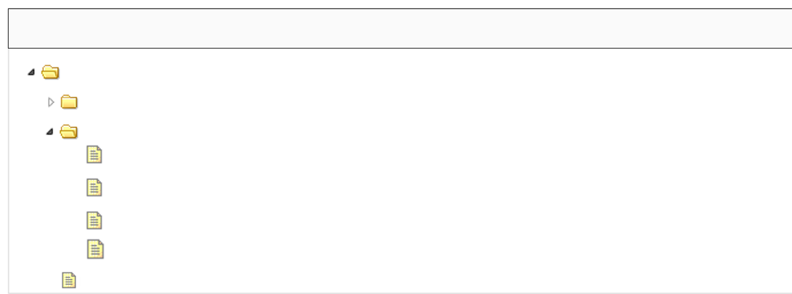
GIS System - Prototype
الخدمات
خدمة نظافة الشوارع والميادين والاراضي الفضاء
Will be generated while creating a contract process
خدمة نظافة الشوارع والميادين والاراضي الفضاء
خدمة التقاط النفايات
1
ربط العمالة
2
ربط المعدات
When double click , It will open new Tab
3
التوزيع الجغرافي للعمالة
4
ربط المعدات بالمسارات *

Slide 5
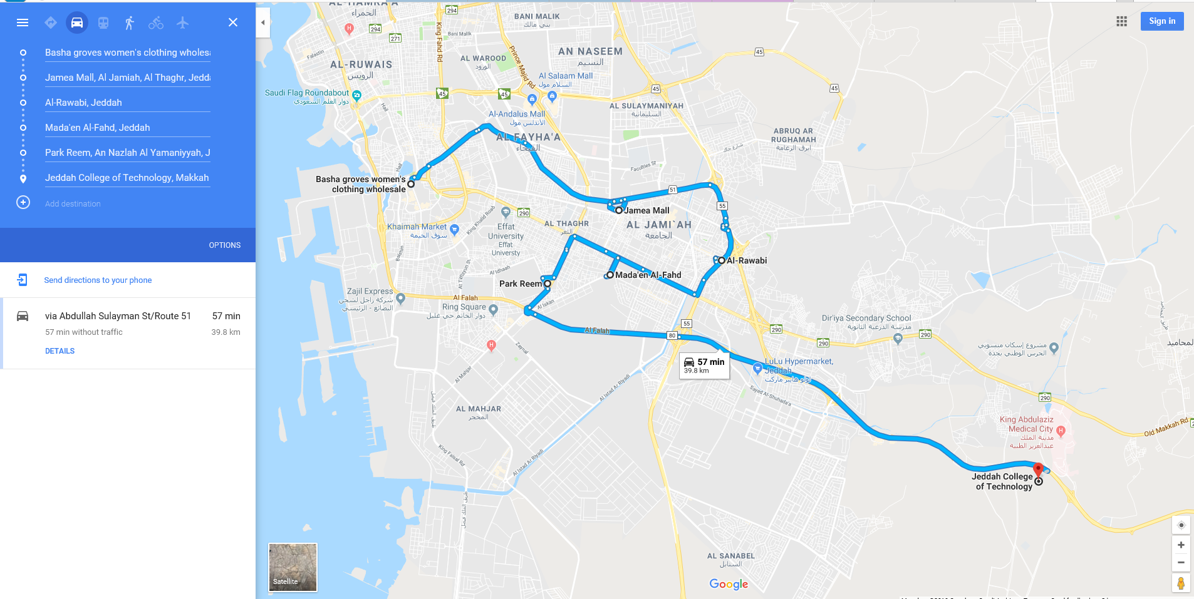
GIS System - Prototype
الخدمات
ربط المعدات بالمسار
Camp
Container 1
Container 2
Container 1
Container 3
Transition station
Container 2
Landfill
Camp
1
2
Container 3
3
Vehicle # 123456
4
Transition Station
Landfill

